Slide 1

Information Retrieval Search Engine
Final Project by Shoham Choclin and Aviel Yitzhak

Slide 2

PERFORMANCE EVOLUTION
From Failure to Success
1
Test 1: Complete Failure
Average Quality: 0.00, Latency: 17.67s. Database connection overhead caused timeouts and empty results. More explanation in the report about the first experiments before the initial fix.
2
Test 2: Initial Fix
Average Quality: 0.324, Latency: 1.9s. Implemented BM25 on body index with parallel threading.
3
Test 3: Optimization
Average Quality: 0.46, Latency: 1.85s. Added weight normalization favoring title scores.
4
Test 4: Final State
Average Quality: 0.49, Latency: 2.18s. Integrated PageView data for ranking boost.

Slide 3
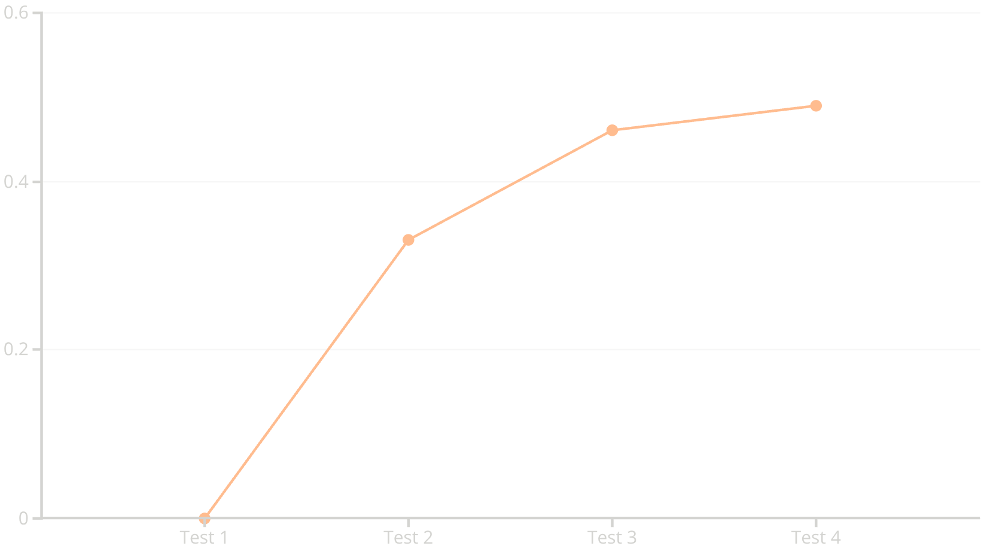
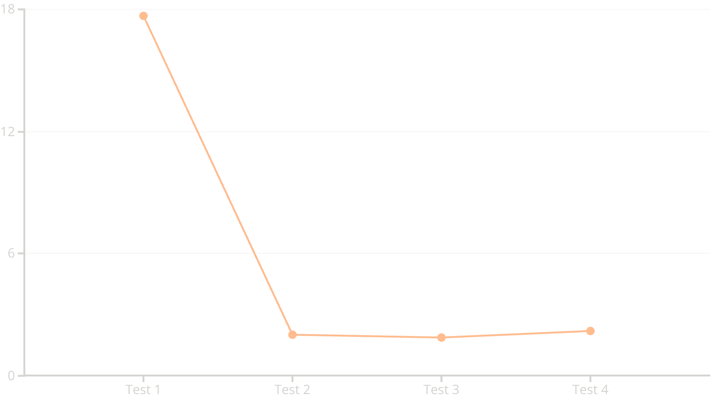
Key Performance Metrics
Quality Improvement
Latency Reduction

Slide 4


SUCCESS
CHALLENGE
Query Analysis: What Worked & What Didn't
Best: "Great Fire of London 1666"
Score: 0.756 | Specific named entities and unique temporal indicator (1666) generated high IDF values. Title/Anchor weighting (0.7 combined) correctly identified exact matches.
Worst: "Ballet origins France Russia"
Score: 0.000 | PageView multiplier dominated ranking. Popular "Russia" page overwhelmed relevance. OR logic allowed single-term matches instead of requiring all terms present.
Corrective Actions Needed
Add Pagerank to the scores
Add query word threshold for long queries with many terms
Identify and mandate presence of rarest query terms

Slide 5
Technical Implementation
01
02
03
BM25 Algorithm
Parallel Threading
IDF Filtering
Replaced cosine similarity with BM25 on body index for improved relevance scoring.
Made search function threadable—body, title, and anchor searches run in parallel.
Ignored postings lists of low IDF terms to reduce computational overhead.
04
05
Weight Normalization
PageView Integration
Adjusted scoring weights to favor title matches, normalizing BM25 scores against title/anchor logic.
Multiplied relevance scores with smoothed PageView data to boost popular pages.
Final Results: 30 successful queries, 0 failures. Average Quality: 0.49 | Average Latency: 2.18 seconds

